Slide 1
JMeter for Performance Testing

Slide 2
Installation steps
Make sure that `java` is in your OS PATH
Download the latest JMeter binary distribution from here:
https://jmeter.apache.org/download_jmeter.cgi
Unzip the archive

Slide 3
JMeter directory content
/bin - Contains JMeter script file for starting JMeter
/docs - JMeter documentation files
/extras - ANT related extra files
/lib/ - Contains the required Java library for JMeter
/lib/ext - contains the core jar files for JMeter and the protocols
/lib/junit - JUnit library used for JMeter

Slide 4
JMeter user interfaces
GUI mode
Command line mode
Server mode (for distributed testing)

Slide 5
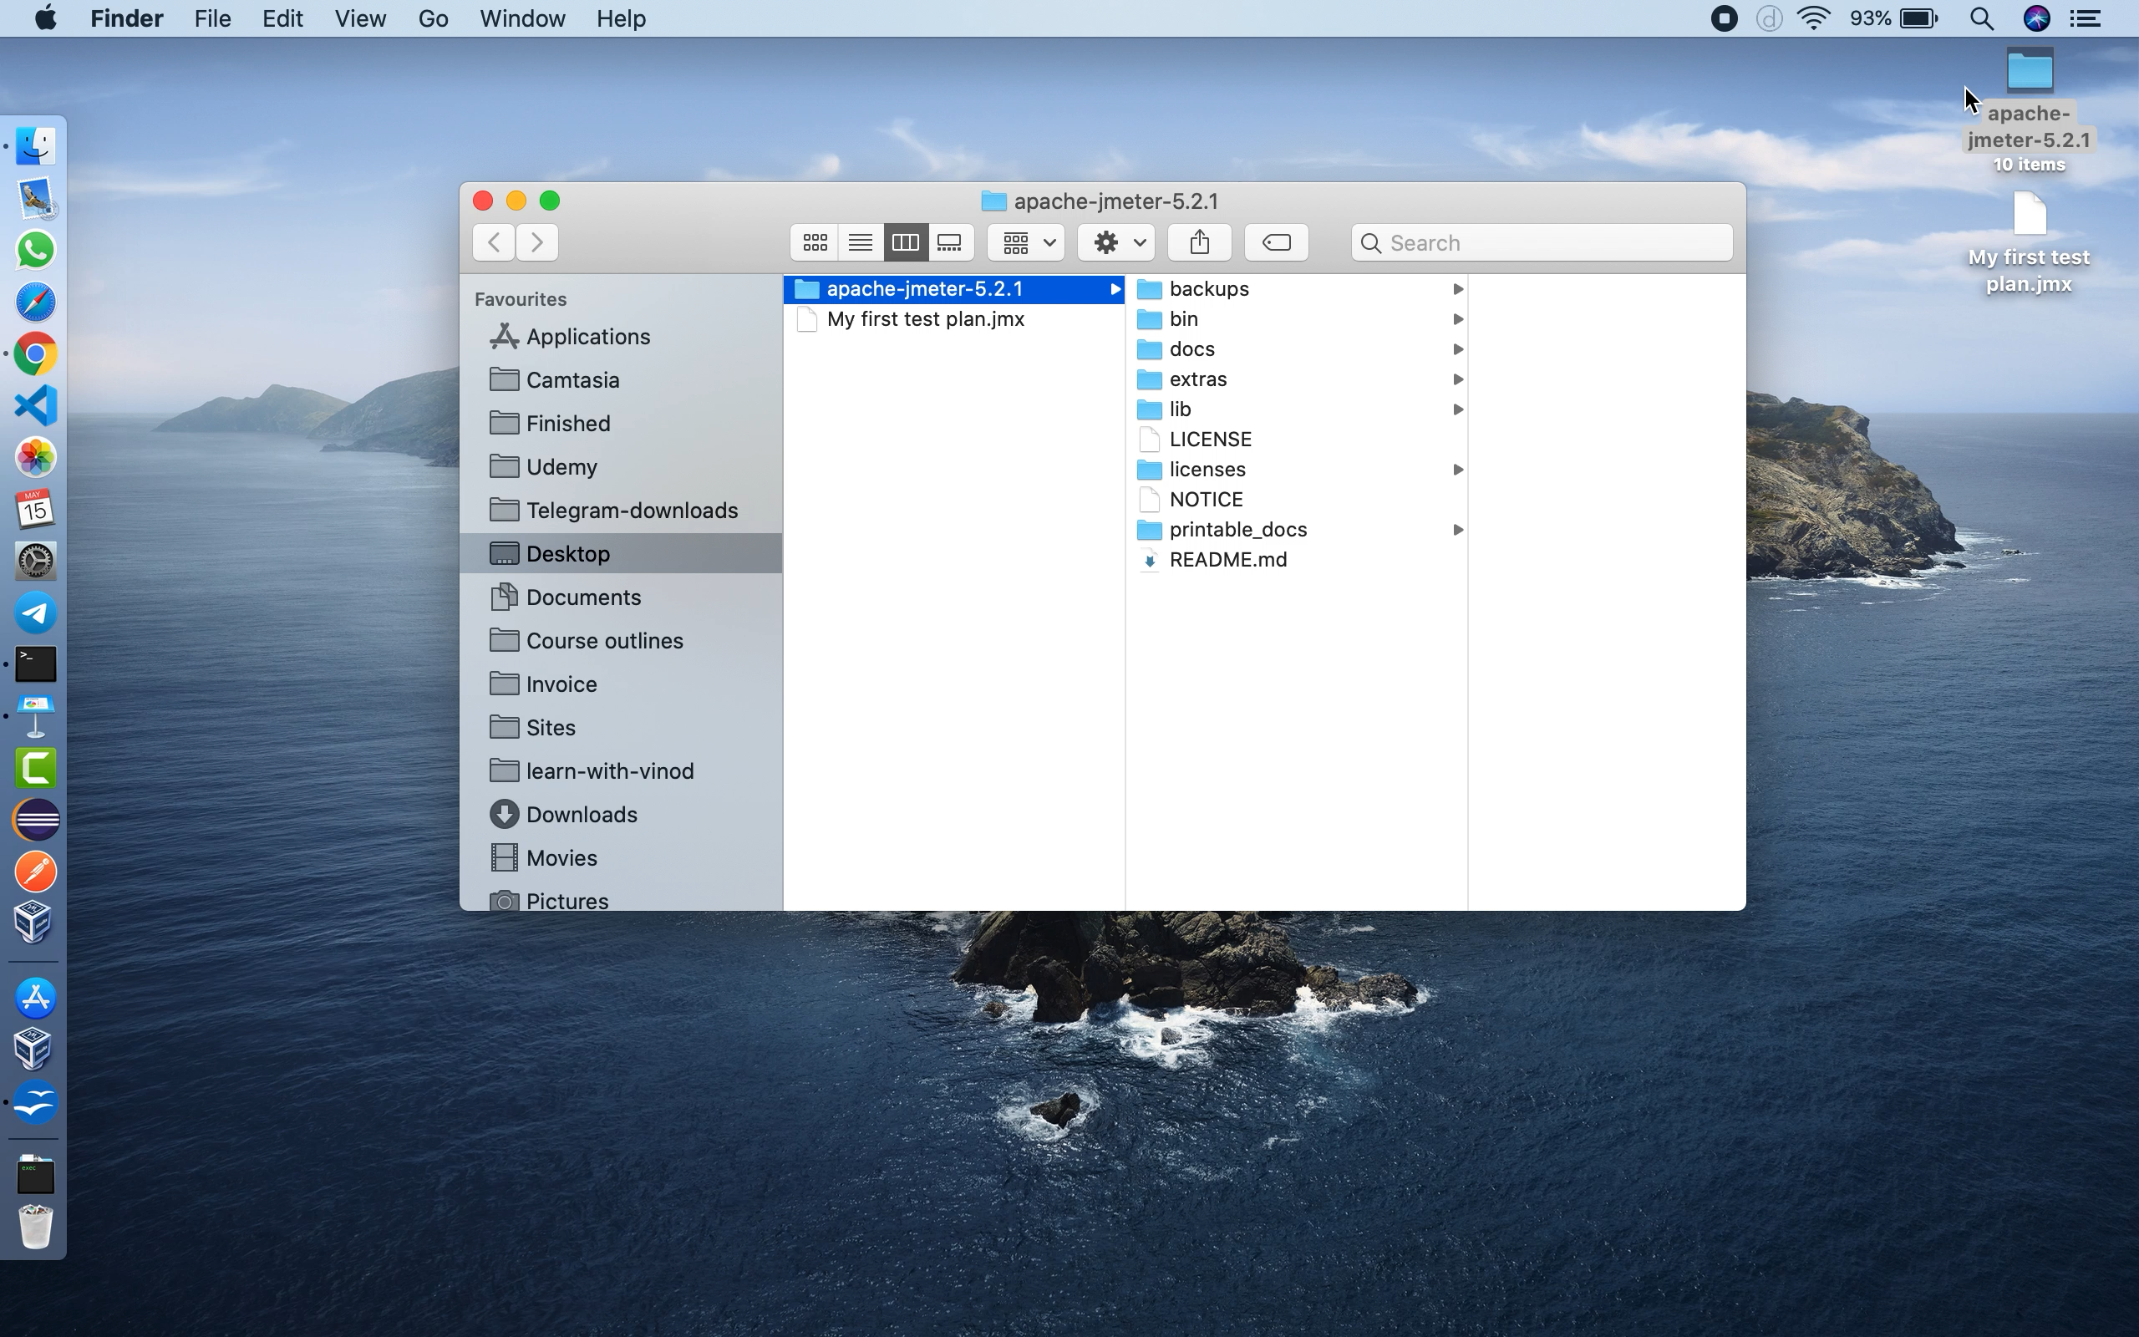

Slide 6
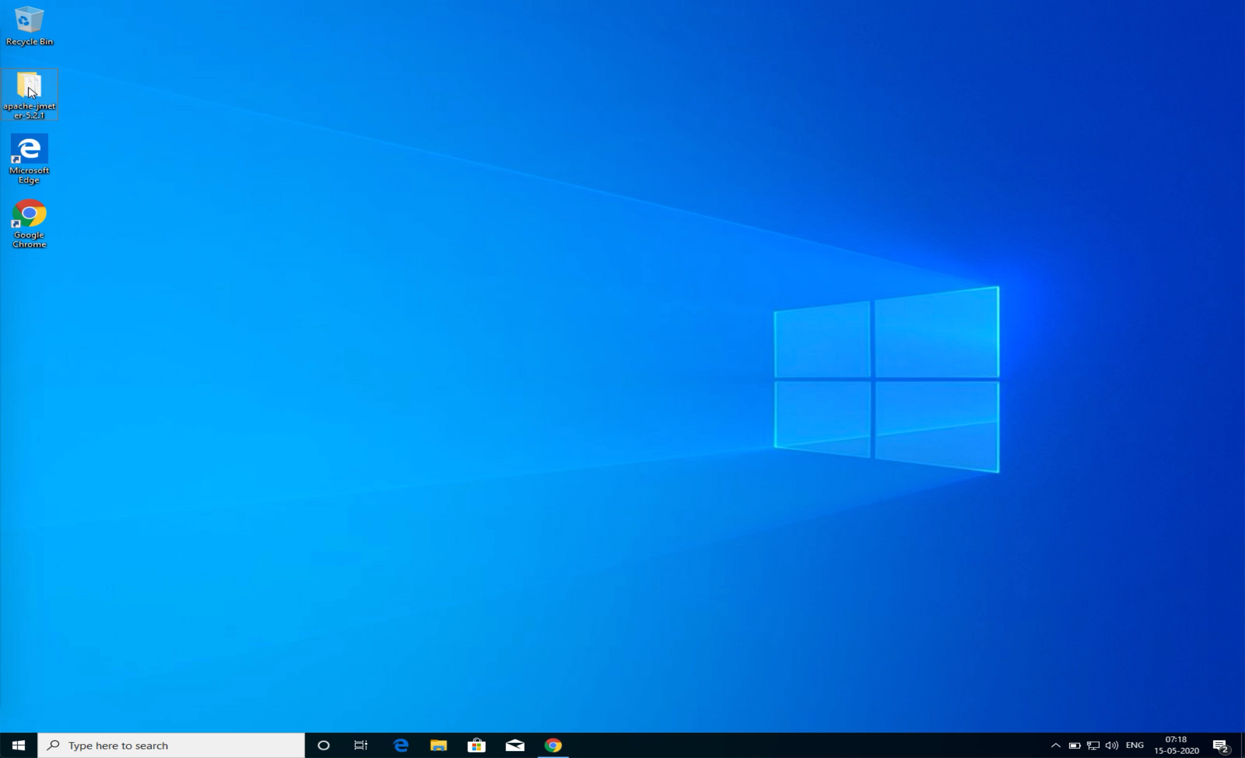

Slide 7
Introduction to JMeter
Open source software
Developed by Apache Software Foundation
Designed to load test a web application
Most commonly used for analyse and measure the performance of a web application
Can also be used for testing many other services
FTP, Functional testing, DB server testing etc.

Slide 8
Prerequisites
Apache JMeter 4+ requires
JDK or JRE version 8+
JDK is preferred
Current version of JMeter is 5.2.1

Slide 9
JMeter features
Free and open source
Friendly GUI
Platform independent
Multithreaded framework
Visualise test result
Easy installation
Highly extensible
Multiple testing strategies
Simulation
Support multiple protocols
Record and playback
Script test
integrates Java and JavaScript

Slide 10
JMeter interface & Vocabulary
Test plan (JMeter script)
Thread group (1 thread = 1 user)
Samplers (make a request)
Listeners (reporting, logging and debugging)
Pre processors (modify the request)
Post processors (parse the response)
Config elements
Timer (add a deliberate delay)
Assertions (error checking)
Logic controllers
Workbench (removed in version 4+)

Slide 11
Test Plan
The Test Plan is where the overall settings for a test are specified.

Slide 12
Thread group
A Thread Group defines a pool of users that will execute a particular test case against your server.
In the Thread Group GUI, you can control
the number of users simulated (number of threads),
the ramp up time (how long it takes to start all the threads),
the number of times to perform the test,
and optionally, a start and stop time for the test.

Slide 13
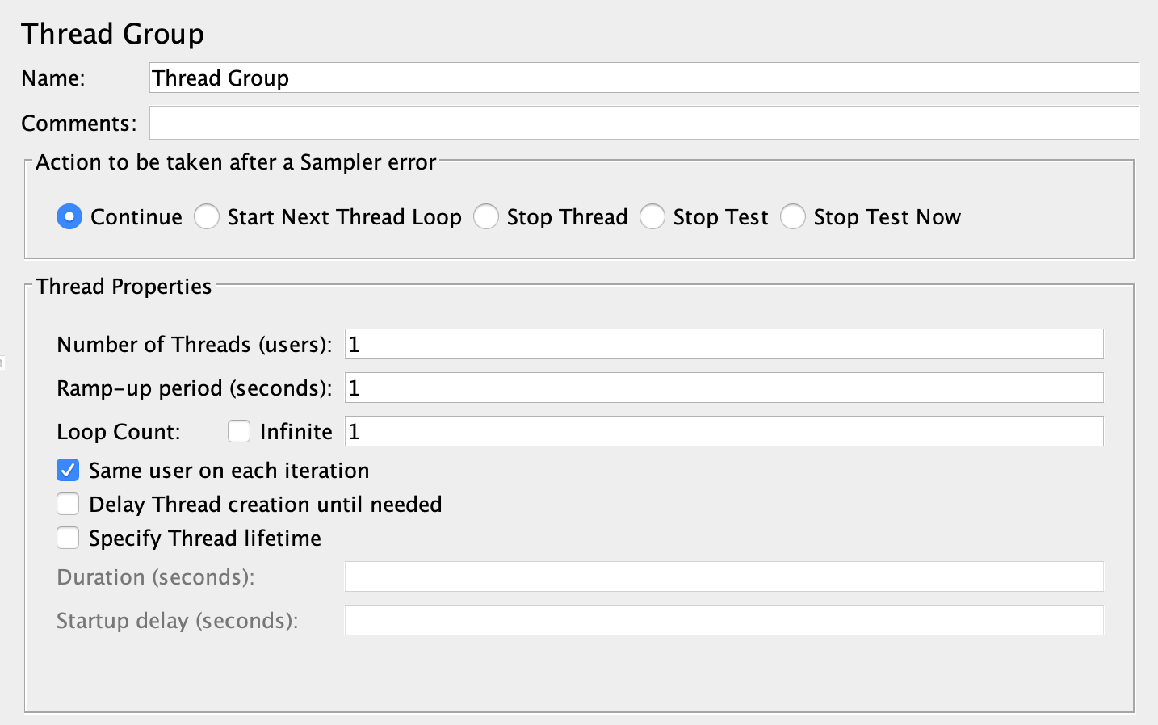

Slide 14
Samplers
Samplers perform the actual work of JMeter.
Each sampler (except Flow Control Action) generates one or more sample results.
The sample results have various attributes (success/fail, elapsed time, data size etc.) and can be viewed in the various listeners.
Http Request is the most commonly used sampler

Slide 15
Http Request Sampler
This sampler lets you send an HTTP/HTTPS request to a web server.
It also lets you control whether or not JMeter parses HTML files for images and other embedded resources and sends HTTP requests to retrieve them.

Slide 16
Http Request Sampler
The following types of embedded resource are retrieved:
images
applets
stylesheets (CSS) and resources referenced from those files
external scripts
frames, iframes
background images (body, table, TD, TR)
background sound

Slide 17
Listeners
Most of the listeners perform several roles in addition to "listening" to the test results.
They also provide means to view, save, and read saved test results.
Note that Listeners are processed at the end of the scope in which they are found.
Listeners can use a lot of memory if there are a lot of samples.

Slide 18
Most common listeners
View Results Tree
View Results in Table
Summary Report
Aggregate Report
Aggregate Graph
Assertion Result
Graph Result
JSR223 Listener
Response Time Graph
Save Response to a file
BeanShell Listener

Slide 19
Logic Controllers
Lets you handle the order of processing Samplers in a Thread
Decide When & How to execute a sampler

Slide 20
Logic Controllers
If Controller
Transaction Controller
Loop Controller
While Controller
Critical Section Controller
ForEach Controller
Include Controller
Interleave Controller
Once Only Controller
Random Controller
Random Order Controller
Recording Controller
Runtime Controller
Simple Controller
Throughput Controller
Module Controller
Switch Controller

